Slide 1
Mine-Max

Slide 2
INTRODUCTION
Mine-Max is a framework for handling any kind of textual unstructured data.
It performs structured and unstructured data mining, storage, analysis and visualization of the data.
The system takes unstructured data from various sources as input.

Slide 3
EXISTING SYSTEM
The existing system is domain oriented, i.e..,
> Stock exchange data > Shopping site data > Medical data, etc.
> Twitter Sentimental analysis
The existing system have complex user interface
Only the programmers can handle the system

Slide 4
PROPOSED SYSTEM
The proposed system can handle all kinds of structured and unstructured data.
Simple and effective user interface.
The system can be handled by anyone.
The system can find out the hidden information from the unstructured data.
It also provides: Data analysis, storage and visualization using various methods.

Slide 5
Working Environment
Editor: Sublime
Front-end: Pyqt5
Back-end: MongoDb
Libraries: Pyqt5,Pymongo,Mathplot,NLTK,
scikit-learn,Pandas

Slide 6
Work Status
Data-Preprocessing
Visualization
Front-end designing

Slide 7
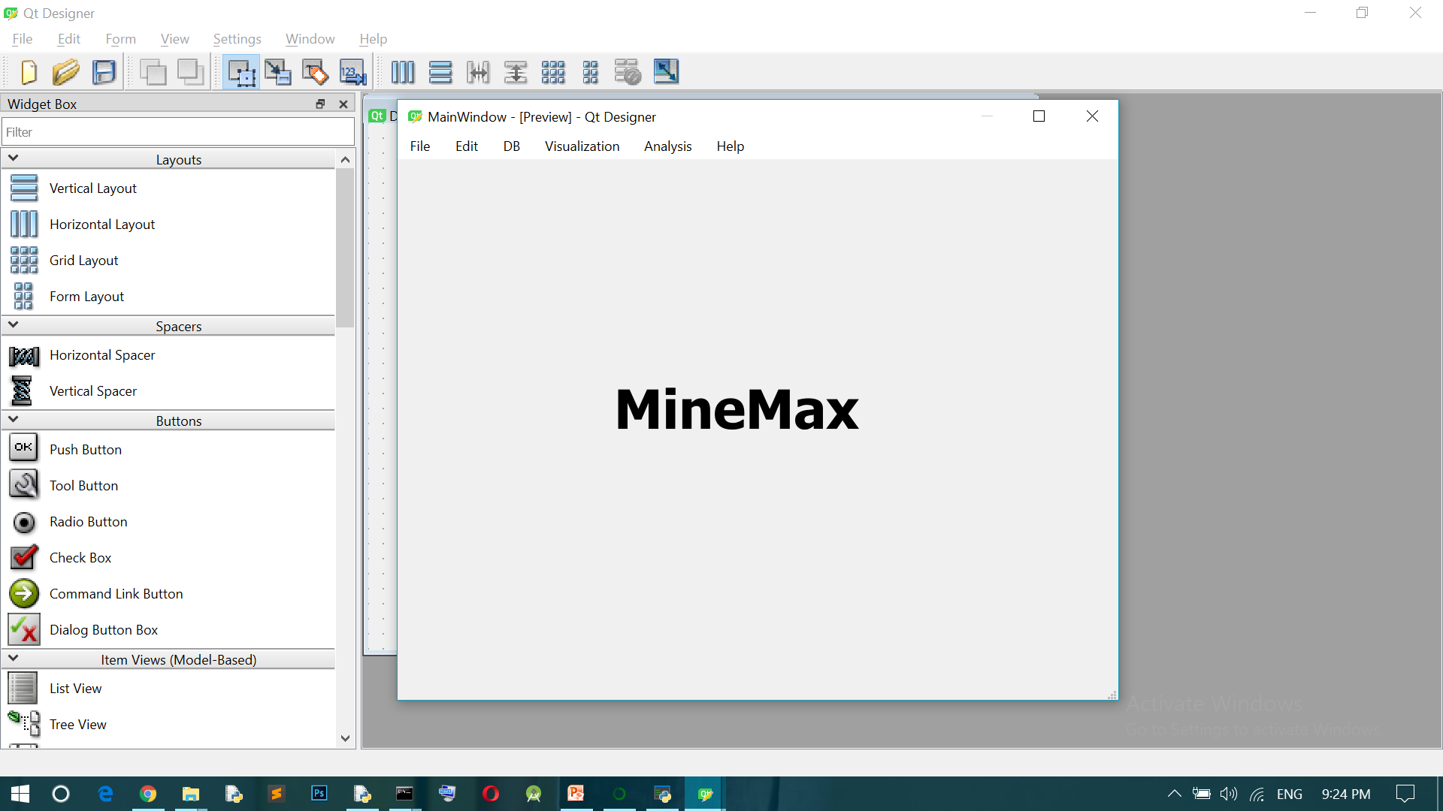
Screenshots

Slide 8
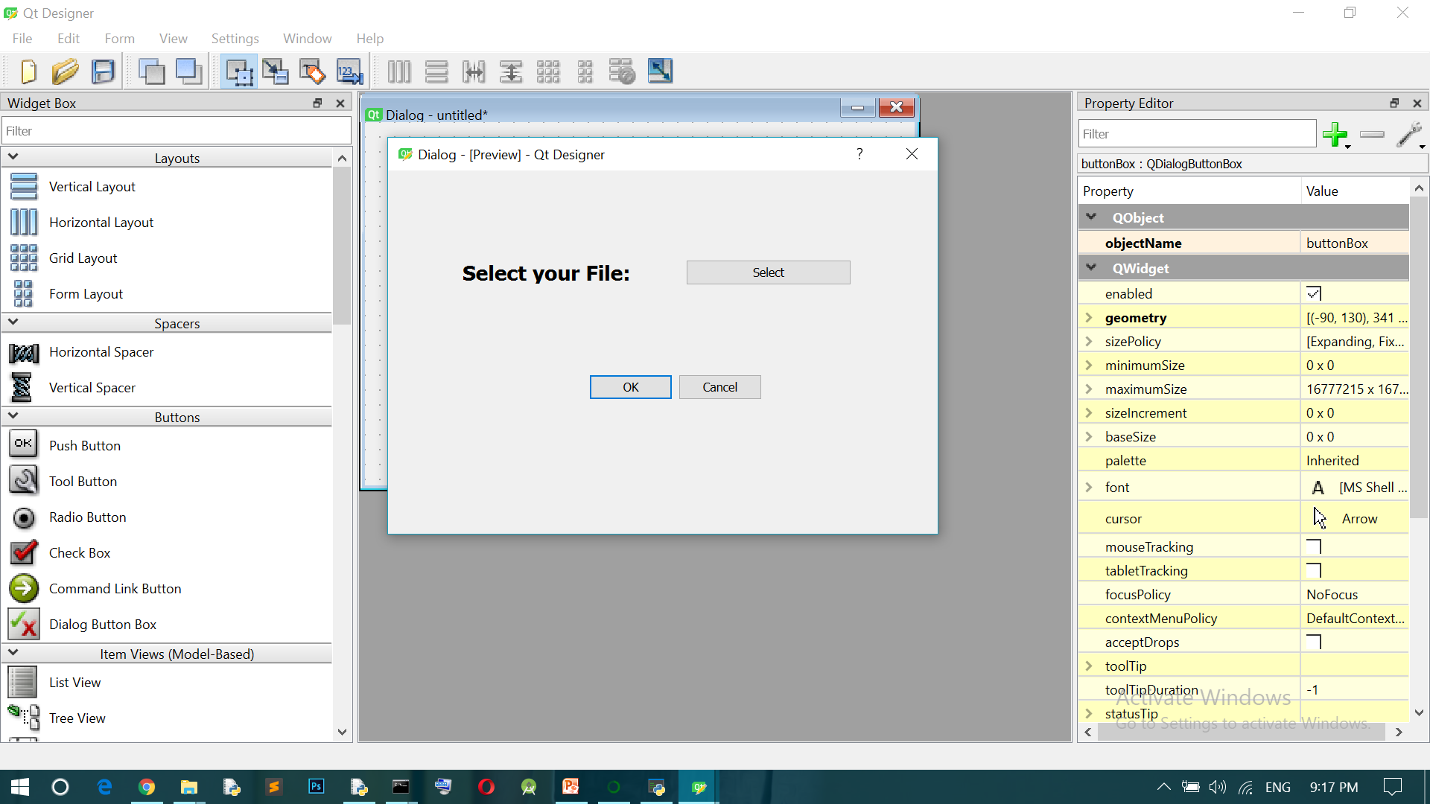
Screenshots

Slide 9
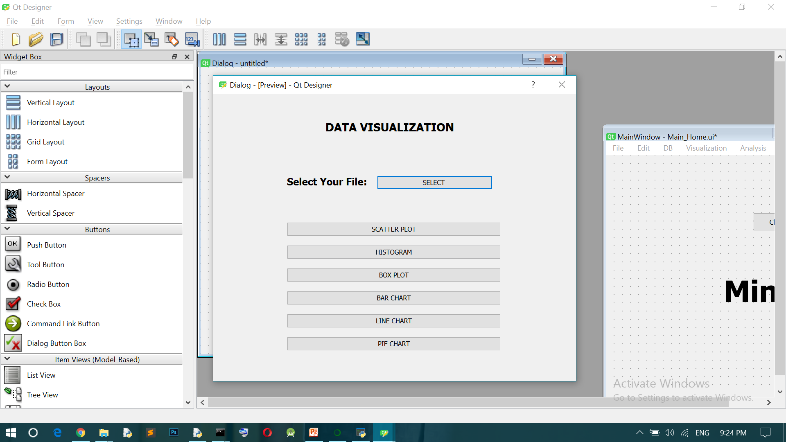
Screenshots

Slide 10
Conclusion
After the beginning section, we decided to implement structured data mining also with unstructured data.
Confusing with the implementation of Tensorflow and keras

Slide 11
THANK YOU

